Slide 1

Software architecture Assignment 2 Smart home system architecture
A system that handles IOT sensor events and execute routines for Lighting, whether control, Gate/Door Control and Security Systems
Akhil Sudhakaran - 2021MT12054 - 2021mt12054@wilp.bits-pilani.ac.in

Slide 2
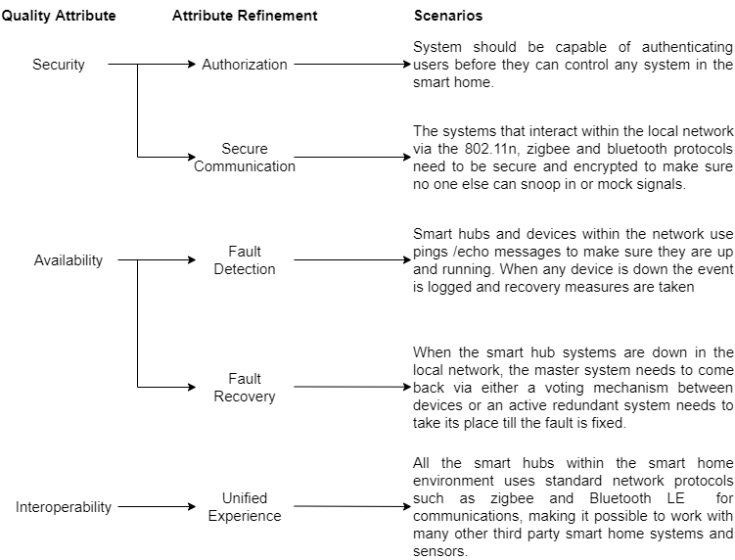
Utility tree of the top 3 ASRs for smart home systems

Slide 3
Tactics to achieve Top 3 ASRs
Quality Attribute | Scenario (Attribute Refinement) | Tactics
Security | Only authorized users can interact with the smart home system. Role based users can also | The hosted cloud application and the hub (for direct local access) will handle requests to the smart home environment after authenticating with SSO (Single Sign On). Other measures such as two factor authentication can also be used. This can be done by integrating to OAuth providers such as google. The application can have Users be put into guest roles and other groups which further helps in segregating the kind of interactions that can be executed in the smart home.
 | The systems within the smart home network should use encryption supported low energy based wireless protocols to make sure the communication channels are secure | Any communication between smart systems must be encrypted with the network key or other tokens created while authenticating the user. We can add new devices to the smart home environment by securely pairing these devices based on device identifier during setup to avoid a malicious device to interact with the environment

Slide 4
Tactics to achieve Top 3 ASRs (Cont.)
Quality Attribute | Scenario (Attribute Refinement) | Tactics
Availability | Detect faults with any systems in the smart home environment. | The smart hub checks for the availability of the systems by employing ping/echo messages. When there is a failure in response after a fixed number of retries then fault recovery can be triggered (This can be done activating the backup redundant system). The hub can also notify the user of failures in the system.
 | Recover faults when it is detected in any system or hub within the smart home system | When the master hub fails, then we can employ active redundancy, where a new hub can come up soon and resume operations and notify the user of the failure. This measure can be employed on other systems and sensors as well
Interoperability | The system interfaces and works with existing popular smart home systems that use standard protocols for communication. | The hub that maintains the smart home network must support popular smart home communication protocols such as ZigBee, Bluetooth LE or Z wave.

Slide 5
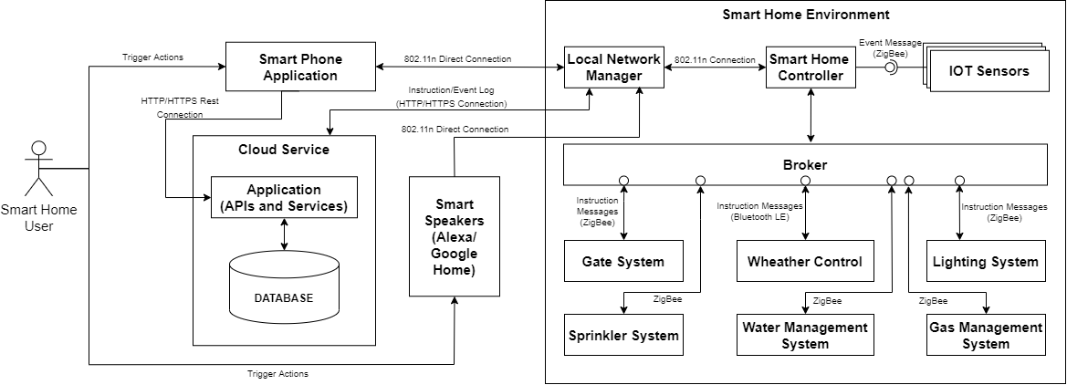
Component Connector Diagram
The following are the interactions that are seen between the major components in the system:
The smart phone application can either send instructions via the cloud hosted services from a remote network or even send them in the local network through Wi-Fi.
The user can also use smart speakers such as Alexa or Google home to give instructions to the hub via the local wifi network
The IOT sensors, and other smart systems use standard low energy communication protocols such as ZigBee or Bluetooth LE. The Gate system, whether control and other systems communicate with the smart home hub through messages sent via a broker.

Slide 6
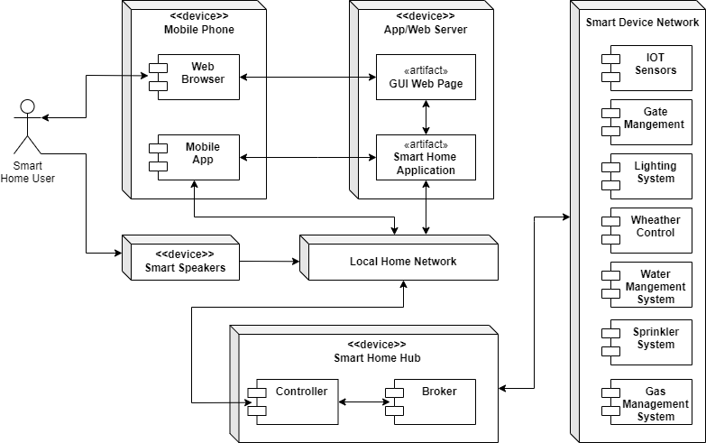
Deployment Diagram

Slide 7
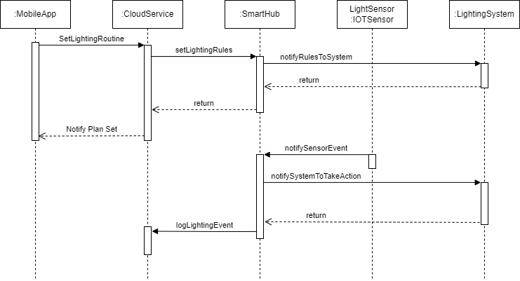
Sequence Diagram For Lighting System Management By a smart home System
The sequence diagram to the right shows the use case of how rules are set for the lighting system’s behavior and how these rules are enforced by the smart hub based on events recorded by the IOT Sensor.
The authenticated user uses the app to set how the lighting should behave based on the signals given by the IOT sensor events (such as darkness level, or presence of a person etc.)
The app sends these rules to the smart hub via the hosted application. The Hub lets the lighting system know about the change in it’s expected behavior.
When the optical IOT sensor sees an event, it notifies it to the smart hub. The hub then notifies the system to take the action based on this event.
The system does the necessary job and notifies the hub which in turn logs the event in the hosted application

Slide 8
Architectural Patterns used

Slide 9
Key Learnings
Apart from thinking about functional requirements it is important to figure out the nonfunctional requirements that can potentially change the way the system is modelled. For example, performance requirements can affect how an entire system is designed and knowing about it early and having the intuition to think about such potential requirements is very important.
Knowing how the system acts as a backbox through a context diagram helps all stakeholders understand the bigger picture. It helps in clearly showing what belongs in a system and what does not.
The analysis of the system in different views (Module decomposition, utility trees, component connection etc.) can be templated and be reused for other similar systems. This helps in deriving more cost vs benefit of different architecture approaches for similar problems in the future.
The module view and component connection diagrams help developers visualize implementation strategies much earlier in system designing and makes planning (especially in AGILE) much easier.
The deployment view gives a clear image to operation teams on how the application modules are deployed and helps in rough estimation of cost early on easing planning.

